Slide 1
ARM
Processor Modes
Department of Computer Science and Engineering
Amrita School of Engineering
Coimbatore
ARM Processor Modes

Slide 2
Processor States
Determines which instruction set is being executed
ARM State – 32 bit instructions
Thumb State – 16 bit instructions
31
28
27
24
23
16
15
8
7
6
5
4
0
N Z C V Q
U n d e f i n e d
I F T mode
T = 0 – ARM State
T = 1 – Thumb State
ARM Processor Modes

Slide 3
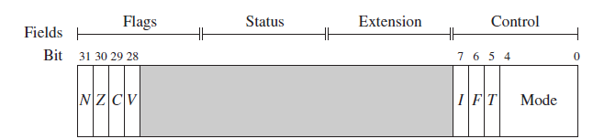
Processor Modes
Processor Modes determine
    Which registers are Active
    Access Rights to CPSR Register itself
Privileged :
      Full Read-Write access to the CPSR
Non-Privileged :
      Only Read access to the Control Field of CPSR
      Read-Write access to the Condition Flags
ARM Processor Modes

Slide 4
Processor Modes
ARM has Seven Processor Modes
Privileged :
    Abort
    Fast Interrupt Request (FIQ)
    Interrupt Request (IRQ)
    Supervisor
    Undefined
    System
Non-Privileged :
    User
ARM Processor Modes

Slide 5
Processor Modes
Abort :
  When there is a failed attempt to access memory
Fast Interrupt Request (FIQ) :
Entered on High Priority Interrupt Request
Interrupt Request (IRQ) :
  Entered on Normal Interrupt Request
Supervisor Mode :
  Mode after Reset and mode in which OS kernel executes
Undefined :
  When the Processor encounters an Undefined Instruction
User :
  Mode in which most Applications run
System :
  Special Version of User Mode that allows Full Read-Write
  access of CPSR
ARM Processor Modes

Slide 6
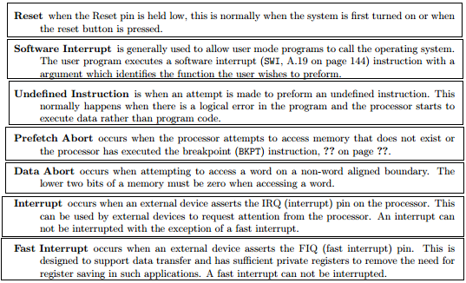
ARM Architecture

Slide 7
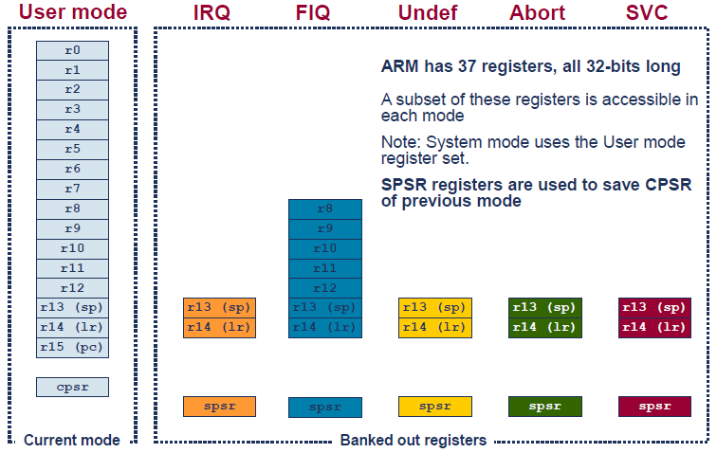
ARM Registers
ARM Processor Modes

Slide 8
Mode Changing
31
28
27
24
23
16
15
8
7
6
5
4
0
N Z C V Q
U n d e f i n e d
I F T mode
Direct write to Mode Bits
On Exception or Interrupt
Exceptions
Reset, FIQ, IRQ, SWI, Data Abort
Pre-fetch Abort and Undefined
M[4:0] | Mode
0b10000 | User
0b10001 | FIQ
0b10010 | IRQ
0b10011 | Supervisor
0b10111 | Abort
0b11011 | Undefined
0b11111 | System
ARM Processor Modes

Slide 9
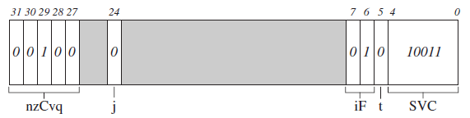
Exercise - CPSR
Mode - Supervisory State - ARM
ARM Processor Modes

Slide 10
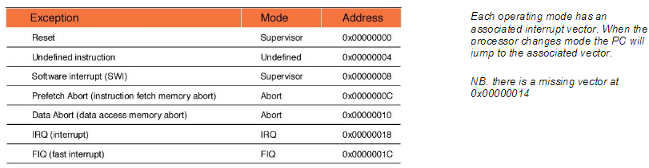
Exception Modes
When an exception occurs, the CPU will change modes and the PC be forced to an exception vector. The vector table starts from address zero with the reset vector and then has an exception vector every four bytes.
ARM by Shriram

Slide 11
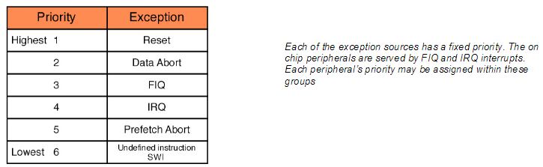
Contd.,
There is a gap in the vector table because there is a missing vector at 0x00000014.
This location was used on an earlier ARM architecture and has been preserved on ARM7 to ensure software compatibility between different ARM architectures.
ARM by Shriram

Slide 12
Mode Changing
User Mode
Actions by Processor when exception occurs
Saves CPSR to SPSR
of exception mode
Saves PC to LR of exception mode
Sets CPSR Mode Bits
to corresponding exception
Sets PC to address of exception handler
IRQ Mode
ARM Processor Modes

Slide 13
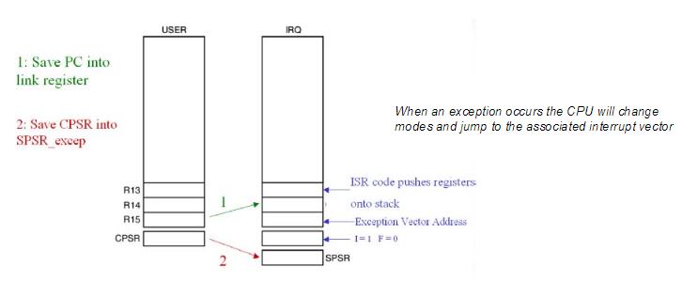
What happens when an exception occurs?
When an exception occurs, for example an IRQ exception, the following actions are taken:
First the address of the next instruction to be executed (PC + 4) is saved into the link register
ARM by Shriram

Slide 14
Contd.,
Then the CPSR is copied into the SPSR of the exception mode that is about to be entered (i.e. SPSR_irq)
The PC is then filled with the address of the exception mode interrupt vector. In the case of the IRQ mode this is 0x00000018 (Refer the table shown earlier.)
ARM by Shriram

Slide 15
Contd.,
At the same time the mode is changed to IRQ mode, which causes R13 and R14 to be replaced by the IRQ R13 and R14 registers.
Once your code has finished processing the exception it must return back to the user mode and continue where it left off.
However the ARM instruction set does not contain a return” or “return from interrupt” instruction so manipulating the PC must be done by regular instructions.
ARM by Shriram

Slide 16
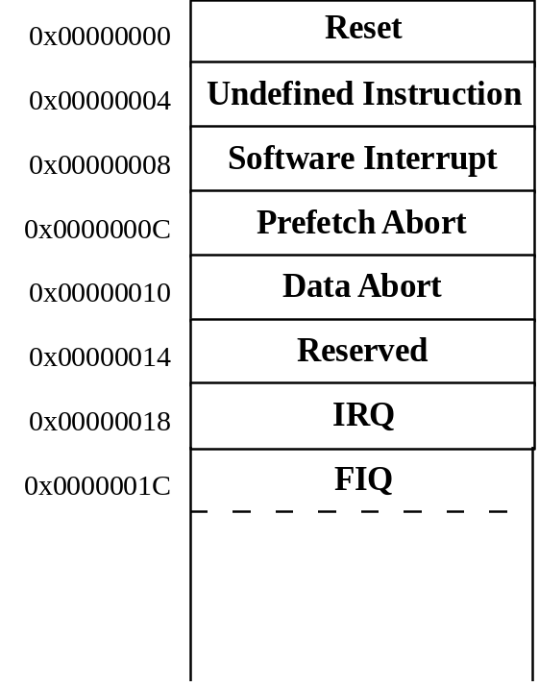
When an exception occurs, the core:
  Copies CPSR into SPSR_<mode>
  Sets appropriate CPSR bits
    If core implements ARM Architecture 4T and is currently in Thumb state, then
      ARM state is entered.
    Mode field bits
    Interrupt disable flags if appropriate.
  Maps in appropriate banked registers
  Stores the “return address” in LR_<mode>
  Sets PC to vector address
To return, exception handler needs to:
  Restore CPSR from SPSR_<mode>
  Restore PC from LR_<mode>
ARM Architecture

Slide 17
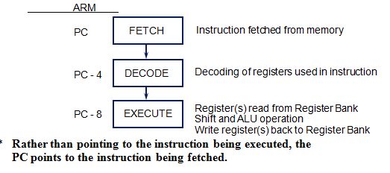
3 Stage - Pipeline
The ARM uses a pipeline in order to increase the speed of the flow of instructions to the processor.
  Allows several operations to be undertaken simultaneously, rather than serially.
Rather than pointing to the instruction being executed, the
PC points to the instruction being fetched.
ARM Architecture

Slide 18
Contd.,
The situation is further complicated by there being a number of different return cases. (Makes life further difficult)
Let us consider three cases! All are very interesting to look into! ☺
ARM by Shriram

Slide 19
Case : 1
Consider the SWI instruction.
In this case the SWI instruction is executed, the address of the next instruction to be executed is stored in the Link register and the exception is processed.
In order to return from the exception all that is necessary is to move the contents of the link register into the PC and processing can continue.
However in order to make the CPU switch modes back to user mode, a modified version of the move instruction is used and this is called MOVS (more about this later).
Hence for a software interrupt the return instruction is
MOVS R15,R14 ; Move Link register into the PC and switch modes.
ARM by Shriram

Slide 20
Case: 2
Consider the FIQ and IRQ instructions, when an exception occurs the current instruction being executed is discarded and the exception is entered.
When the code returns from the exception the link register contains the address of the discarded instruction plus four.
In order to resume processing at the correct point we need to roll back the value in the Link register by four.
In this case we use the subtract instruction to deduct four from the link register and store the results in the PC.
As with the move instruction, there is a form of the subtract instruction which will also restore the operating mode. For an IRQ, FIQ or Prog Abort, the return instruction is:
SUBS R15, R14,#4
ARM by Shriram

Slide 21
Case: 3
In the case of a data abort instruction, the exception will occur one instruction after execution of the instruction which caused the exception.
In this case we will ideally enter the data abort ISR, sort out the problem with the memory and return to reprocess the instruction that caused the exception. In this case we have to roll back the PC by two instructions i.e. the discarded instruction and the instruction that caused the exception.
In other words subtract eight from the link register and store the result in the PC. For a data abort exception the return instruction is
SUBS R15, R14,#8
ARM by Shriram

Slide 22
Thank
You
Thanks to Mr KP Peeyush and Dr K V Shriram

